Slide 1
DATA STRUCTURE AND ALGORITHM
3RD SEMESTER

Slide 2
SYLLABUS
Unit 1: Introduction to Data Structure (2 Hrs.) Definition, Abstract Data Type, Importance of Data Structure.
Unit 2: The Stack (3 Hrs.) Introduction, Stack as an ADT, POP and PUSH Operation, Stack Application: Evaluation of Infix, Postfix, and Prefix Expressions, Conversion of Expression.
Unit 3: Queue (3 Hrs.) Introduction, Queue as an ADT, Primitive Operations in Queue, Linear and Circular Queue and Their Application, Enqueue and Dequeue, Priority Queue.

Slide 3
Unit 4: List (2 Hrs.) Introduction, Static and Dynamic List Structure, Array Implementation of Lists, Queues as a List.
Unit 5: Linked Lists (5 Hrs.) Introduction, Linked List as an ADT, Dynamic Implementation, Insertion & Deletion of Node To and From a List, Insertion and Deletion After and Before Nodes, Linked Stacks and Queues, Doubly Linked Lists and Its Advantages.
Unit 6: Recursion (4 Hrs.) Introduction, Principle of Recursion, Recursion vs. Iteration, Recursion Example: TOH and Fibonacci Series, Applications of Recursion, Search Tree.
Unit 7: Trees (5 Hrs.) Introduction, Basic Operation in Binary tree, Tree Search and Insertion/Deletion, Binary Tree Traversals (pre-order, post -order and in-order), Tree Height, Level, and Depth, Balanced Trees: AVL Balanced Trees, Balancing Algorithm, The Huffman Algorithm, Game tree, B-Tree.

Slide 4
Unit 8: Sorting (5 Hrs.) Introduction, Internal and External Sort, Insertion and Selection Sort, Exchange Sort, Bubble and Quick Sort, Merge and Radix Sort, Shell Sort, Binary Sort, Heap Sort as Priority Queue, Efficiency of Sorting, Big 'O' Notation.
Unit 9: Searching (5 Hrs.) Introduction to Search Technique; essential of search, Sequential search, Binary search, Tree search, General Search Tree, Hashing: Hash Function and Hash Table, Collision Resolution Technique, Efficiency Comparisons of Different Search Technique.
Unit 10: Graphs (5 Hrs.) Introduction, Graphs as an ADT, Transitive Closure, Warshall's Algorithm, Types of Graph, Graph Traversal and Spanning Forests, Kruskal's and Round-Robin Algorithms, Shortest-Path Algorithm, Greedy Algorithm, Dijkstra's Algorithm.
Unit 11: Algorithms (5 Hrs.) Deterministic and Non-deterministic Algorithm, Divide and Conquer Algorithm, Series and Parallel Algorithm, Heuristic and Approximate Algorithms.

Slide 5
Laboratory Works:
There shall be 10 lab exercises based on C or Java
Implementations of different operations related to Stack
Implementations of different operations related to linear and circular queues
Solutions of TOH and Fibonacci Series using Recursion
Implementations of different operations related to linked list: singly and doubly linked
Implementation of trees: AVL trees, Balancing of AVL
Implementation of Merge sort
Implementation of different searching technique: sequential, Tree and Binary
Implementation of Graphs, Graph traversals
Implementation of Hashing
Implementations of Heap

Slide 6
Prerequisites:
Knowledge of C program (preferred)
Or Java
Note:-
The complete C programs involved in this subject are not studied here.
You will implement the concept already learned in previous semester.
From the examination point of writing algorithms and functions are important

Slide 7
Unit 1: Introduction to Data Structure (2 Hrs.)

Slide 8
Definition
Abstract Data Type
Importance of Data Structure.

Slide 9
What is data structure?
Data Structure A data structure organizes and establishes relationships among data items, serving as the building blocks of a program. It defines:
Data organization
Access methods
Associations between data
Processing options
Choosing the right data structure is essential for implementing an algorithm effectively.
Algorithm + Data Structure = Program

Slide 10
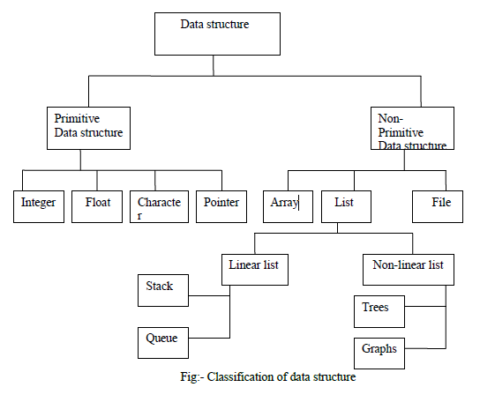
Classification of data structure

Slide 11
Primitive data structure
Primitive Data Structures Basic data structures directly operated by machine instructions. Examples:
Integer
Float
Character
Pointer
Double

Slide 12
Non- primitive data structure
Non-Primitive Data Structures
Highly developed and complex data structures
Derived from primitive data structures
Organize groups of homogeneous and heterogeneous data elements
Examples:
Arrays
Lists
Files

Slide 13
Linear and non-linear data structure
Linear data structure:
All the data elements are arranged in linear order
Data are stored in non hierarchical order where each element has predecessor and successor except first and last
Example of linear data structure are
Array, stack, queue and linked list

Slide 14
Non linear data structure:
The data structure doesn't form a sequence i.e. each element is connected with two or more items in a non-linear arrangement
Data are arranged in some arbitrary function
For example: tree, graph etc.

Slide 15
Abstract data type
Abstract Data Type (ADT)
Functional definition of a data structure, independent of implementation
Consists of a data type and a set of operations for manipulation
Specified in an implementation-independent manner
Focuses on mathematical properties, ignoring implementation constraints

Slide 16
Algorithm
Algorithm
A finite sequence of instructions to solve a stated problem
A stated problem is a well-defined, solvable task
Must terminate and produce a result
Characteristics of an Algorithm:
Input
Output
Finiteness – Should complete in a finite number of steps
Unambiguous – Clearly stated instructions
Effectiveness – Achieves the desired outcome efficiently

Slide 17
Write an algorithm to find largest of three numbers

Slide 18
Write an algorithm to find largest of two numbers
Algorithm to Find the Greatest of Three Numbers
Start
Read three numbers: A, B, and C
Check if A > B
If true, check if A > C
If true, print A as the greatest number
If false, print C as the greatest number
If false, check if B > C
If true, print B as the greatest number
If false, print C as the greatest number
End

Slide 19
Algorithm Analysis
Analysis of the Algorithm
An algorithm is a well-defined set of instructions for solving a problem.
Once the algorithm is finalized, its performance is analyzed based on:
Time Complexity – Measures the execution time based on input size.
Space Complexity – Evaluates the memory required for execution.
Efficient algorithms optimize both time and space for better performance.

Slide 20
Algorithm Analysis
1. Time Complexity
Measures the execution time of an algorithm based on input size.
Expressed using Big-O notation (e.g., O(1), O(n), O(log n), O(n²)).
Best case, worst case, and average case complexities are considered.
2. Space Complexity
Evaluates the memory required by an algorithm during execution.
Includes input storage, auxiliary space, and recursion stack space.
Expressed using Big-O notation (e.g., O(1), O(n), O(n²)).
Optimizing time and space complexity ensures efficient algorithm performance.

Slide 21
THANK YOU

